Slide 1
Texture Mapping
Dr. Sk. Md. Masudul Ahsan
Professor
CSE, KUET
Md. Tajmilur Rahman
Lecturer
CSE, KUET

Slide 2
Outlines
What is Texture Mapping
Why Texture Mapping
Linear Texture Mapping
Mipmapping
Texture Related OpenGL Functions
Texture Wrapping
Texture Filtering

Slide 3
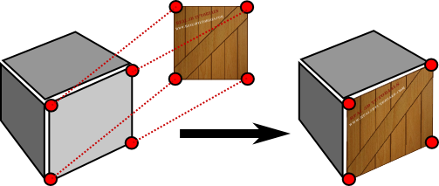
What is Texture Mapping
Texture mapping is the electronic equivalent of applying wallpaper, paint, or veneer to a real object.

Slide 4
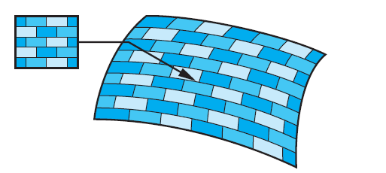
Texture Mapping
Texture mapping uses an image (or texture) to influence the color of a fragment.
Textures can be specified using a fixed pattern, such as the regular patterns often used to fill polygons;
  by a procedural texture-generation method;
  or through a digitized image.

Slide 5
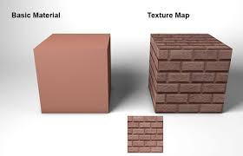
Why Texture Mapping
Adds realism to the scene
Draw a large brick wall without texturing, each brick must be drawn as a separate polygon
But With texturing a large flat wall is just a single polygon

Slide 6
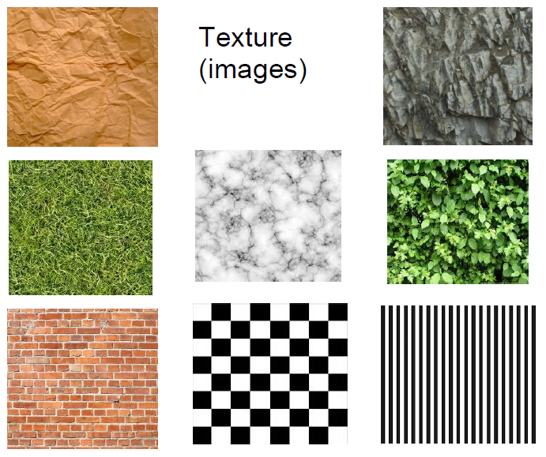
Example of Texture

Slide 7
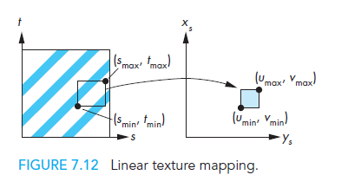
Linear Texture Mapping
Do a direct mapping of a block of texture to a surface patch:

Slide 8
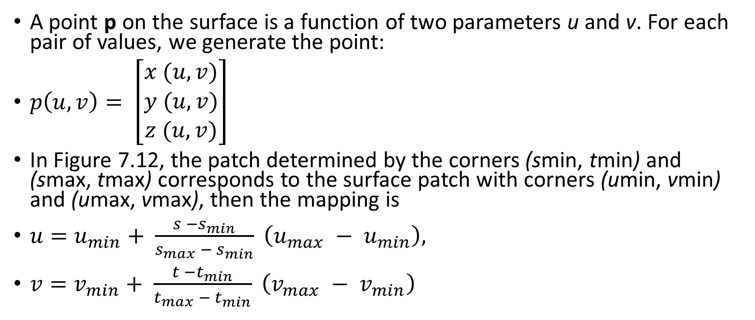
Linear Texture Mapping
A point p on the surface is a function of two parameters u and v. For each pair of values, we generate the point:
$p\left(u,v\right)= \left[\begin{matrix}x (u,v) \\ y (u,v) \\ z (u,v)\end{matrix}\right]$
In Figure 7.12, the patch determined by the corners (smin, tmin) and (smax, tmax) corresponds to the surface patch with corners (umin, vmin) and (umax, vmax), then the mapping is
${u=u}_{min}+ \frac{s −s_{min}}{s_{max} − s_{min}} \left(u_{max} − u_{min}\right),$
${v=v}_{min}+ \frac{t −t_{min}}{t_{max} − t_{min}} \left(v_{max} − v_{min}\right)$

Slide 9
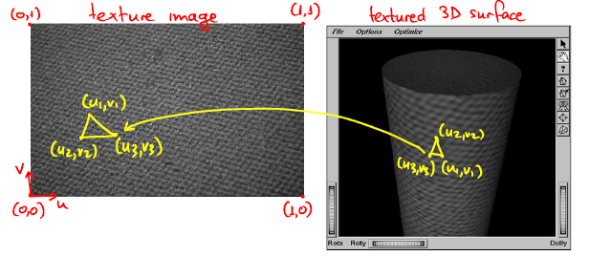
Two Dimensional Texture Mapping

Slide 10
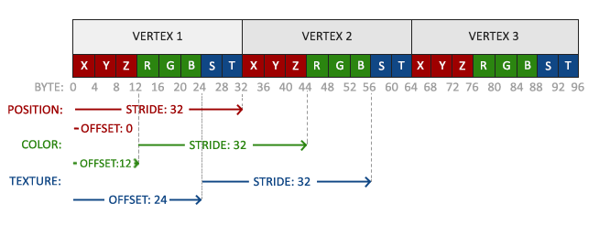
The VAOs

Slide 11
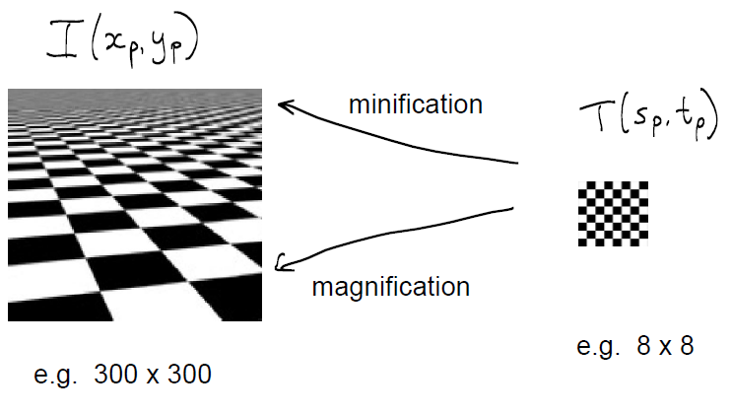
Mipmapping

Slide 12
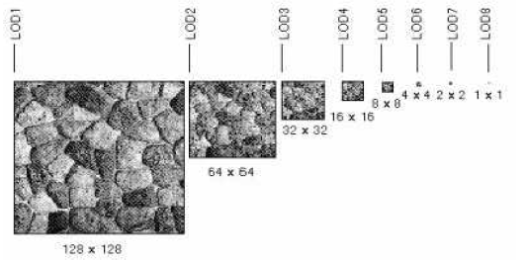
Mipmapping
Pre-calculate how the texture should look at various distances, then use the appropriate texture at each distance. This is called mipmapping. (OpenGL will help us in this regard)

Slide 13
Texture Related OpenGL Functions: glBindTexture()
unsigned int textureID;
glGenTextures(1, &textureID);
glBindTexture(GL_TEXTURE_2D, textureID);
GL_TEXTURE_2D: Specify that it is a 2D texture
textureID: ID of the texture

Slide 14
Texture Related OpenGL Functions: glTexImage2D()
glTexImage2D(GL_TEXTURE_2D, level, components, width, height, border, format, type, tarray)
GL_TEXTURE_2D: Specify that it is a 2D texture
Level: Used for specifying levels of detail for mipmapping
Components: Generally is 0 which means GL_RGB, Represents components and resolution of components
Width, Height: The size of the texture must be powers of 2
Border: Not used here.
Format: Specify what the data is (GL_RGB, GL_RGBA, …)
Type: Specify data type (GL_UNSIGNED_BYTE, GL_BYTE, …)
tarray: Pointer to CPU-side image data from stbi_load()

Slide 15
Texture Related OpenGL Functions: glTexParameteri()
glTexParameteri(GL_TEXTURE_2D, GL_TEXTURE_MAG_FILTER, GL_LINEAR);
This function sets several texture mapping parameters. These parameters are bound to the current texture.
parameters:
P1: GLenum: The texture target for which this parameter applies. Must be one of GL_TEXTURE_1D, GL_TEXTURE_2D, GL_TEXTURE_3D, or GL_TEXTURE_CUBE_MAP.
P2: GLenum: The texturing parameter to set. GL_TEXTURE_MAG_FILTER Returns the texture magnification filter value
P3: GLfloat or GLfloat* or GLint or GLint*: Value of the parameter specified by pname.

Slide 16
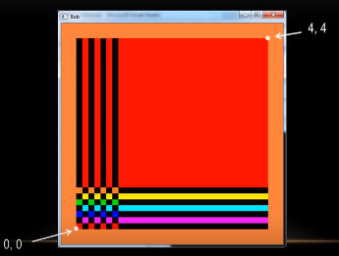
Texture Wrapping: GL_CLAMP

Slide 17
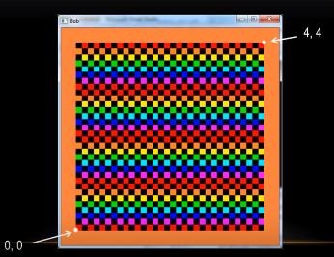
Texture Wrapping: GL_REPEAT

Slide 18
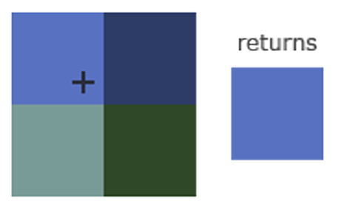
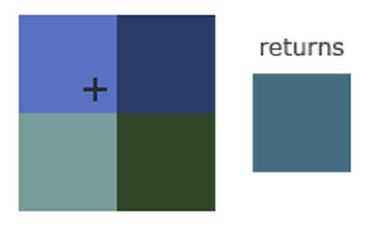
Texture Filtering
GL_NEAREST (also known as nearest neighbor or point filtering) selects the texel that center is closest to the texture coordinate
GL_LINEAR (also known as (bi)linear filtering) takes an interpolated value from the texture coordinate’s neighboring texels, approximating a color between the texels.

Slide 19
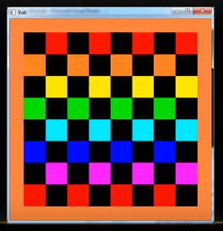
Texture Filtering: GL_NEAREST

Slide 20
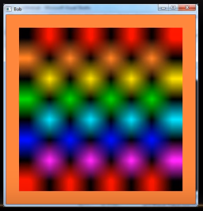
Texture Filtering: GL_LINEAR

Slide 21
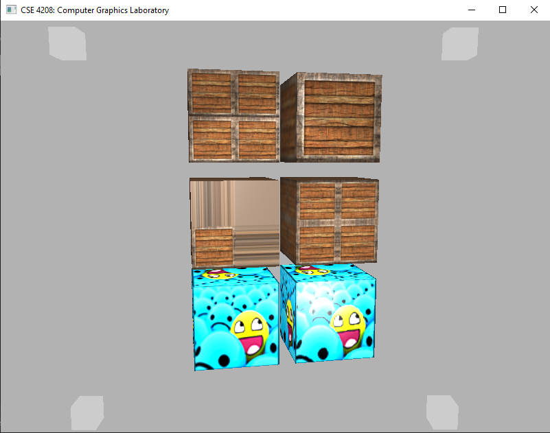
GL_REPEAT, GL_CLAMP_TO_EDGE, GL_MIRRORED_REPEAT, GL_LINEAR, GL_NEAREST

Slide 22
Assignment
Add multiple textured objects in your project with:
  simple texture without surface color
  blended texture with surface color
    Color computed on the vertex
    Color computed on the fragment
Add textured curvy surfaced object (at least sphere and cone) in your project.
Add keyboard interactions to toggle the features

Slide 23
References
https://learnopengl.com/Getting-started/Textures

